Slide 1
COMP1531
Tutorial 5

Slide 2
Today’s Agenda:
Networks & HTTP
Flask
CRUD
State
Authentication
Authorisation

Slide 3
Activity 1 - API
In groups of 3 (no one from you project group), you will be given time to analyse the current API specification by Sally/Bob, and to (as a team) propose one (or a couple) of new "route(s)" (i.e. url) to the interface to add some cool functionality to the product. Find something that you as a team get excited about. You'll be sharing your answer with the class, and will be expected to provide for each route:
A route (i.e. /this/url/name)
A CRUD method (e.g. GET)
Input parameters
Return object
Description of what it does

Slide 4
Questions:

Slide 5
1: What is the difference between the internet and the World Wide Web?

Slide 6
1: What is the difference between the internet and the World Wide Web?
Internet is a network where computers communicate over a series of protocols, SSH, FTP, HTTP, IMAP, SMTP.
SSH: security; encryption
FTP: File transfer
HTTP: formatting of web pages
IMAP & SMTP: used in Email
The world wide web is a network where people use URLs sent over HTTP to access documents and resources

Slide 7
2: key components of an HTTP URL? http://unsw.com/calendar/view?term=t3&week=5#top

Slide 8
2: key components of an HTTP URL? http://unsw.com/calendar/view?term=t3&week=5#top
Protocol:
http
This is the network protocol used
Domain:
unsw.com
This is the key used on DNS servers to look up a particular IP.
Think of DNS servers like a dictionary of domain:IP pairs
Path:
/calendar/view
This denotes the specific page/resource you want to view

Slide 9
http://unsw.com/calendar/view?term=t3&week=5#top
Query string:
?term=t3&week=5
A way of passing data to the server via the URL
Anchor:
top
Information often used to determine the particular state of the same resource loaded from the server.
Common uses for this will be the anchor will specify a particular COMMENT on a forum to "jump" to after loading a forum page

Slide 10
3)a): What is a route?

Slide 11
3)a): What is a route?
A route is a path for your flask server
They are endpoints in a server
requests get sent from the users actions -> routes do necessary back end processing -> may/may not return results of user actions to the front end
Example: app.route(“/home”)

Slide 12
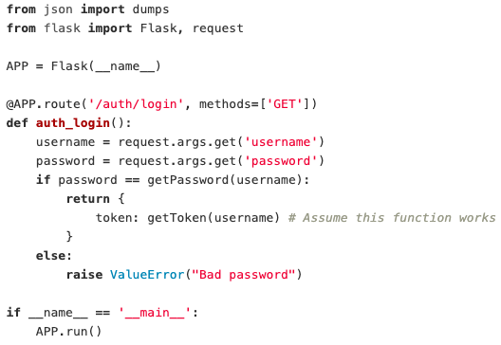
3)b): What’s wrong with this route?

Slide 13
3)b): What’s wrong with this route?
Raising exceptions causes the program to go into an unconventional state
Often, if we don’t catch/handle these exceptions, the program will crash from that state
We need more elegant ways (specifically that don’t crash the website, for dealing with errors if we want people to use our websites

Slide 14
4: What is an API? What are some examples of APIs you have seen/used?

Slide 15
4: What is an API? What are some examples of APIs you have seen/used?
“application program interface”: is a set of functions and capabilities that describe a system or service
Describe how systems should interact
Example: Google Maps, Youtube, TCP network protocol
TCP defines functions for clients and servers for sending data to each other, that’s why you can write a network client in any language and it still works so long as it conforms to the description of the protocol

Slide 16
5: with CRUD, How do we access data passed in on GET, POST, PUT, DELETE?

Slide 17
5: with CRUD, How do we access data passed in on GET, POST, PUT, DELETE?
Create, read, update and delete = CRUD, this isn’t flask specific
Flask uses GET, POST, PUT, DELETE to execute CRUD functions
Flask: all kinds of requests need -> from flask import request
GET Requests:
request.args.get('argument_key')
POST, PUT, DELETE:
request.form.get('argument_key')

Slide 18
6: Looking at the week 4 Point server from lectures, what challenges would we face when trying to test this with the code below?
# Test that a point can be set with the right values
def test_1():
point = Point(1, 1)
assert(point.getX() == 1)
assert(point.getY() == 1)
# Test that an unmodified point starts as none
def test_2():
global point
assert(point is None)

Slide 19
The main challenge is that the state of the program won't be reset between functions.
One simple way to solve this is to write a global function called "reset" which when called resets the state of the data.
def dataReset():
global point
point = None
def dataGet():
global point
return point
def test_2():
dataReset()
data = dataGet()
assert(data is None)

Slide 20
Last Question: What is the difference between authentication and authorisation? Provide an example of the difference between the two.

Slide 21
Last Question: What is the difference between authentication and authorisation? Provide an example of the difference between the two.
Authentication: Confirming an identity
Authorisation: Providing access to resources based on their identity
E.x.
Authentication: auth/login is a function that authenticates a user, user receives a token to be used for authorisation.
Authorisation: on subsequent function calls a token is passed in to authorise access to that particular route.

